Slide 1
AGRIDRONE
- SMART AGRICULTURE USING IOT

Slide 2
PRESENTED BY:
Dr . s.arulselvi associate professor (guide)
N.CHANDRIKA(U17EC315)
M.SUREKHA(U17EC344)
P.SHRIYA(U17EC306)

Slide 3
CONTENT
Introduction
Abstract
What is AGRIDRONE….?
Literature survey
Agridrone Market
Applications
Proposed System
Existing system
Block Diagram
Conclusion
Reference

Slide 4
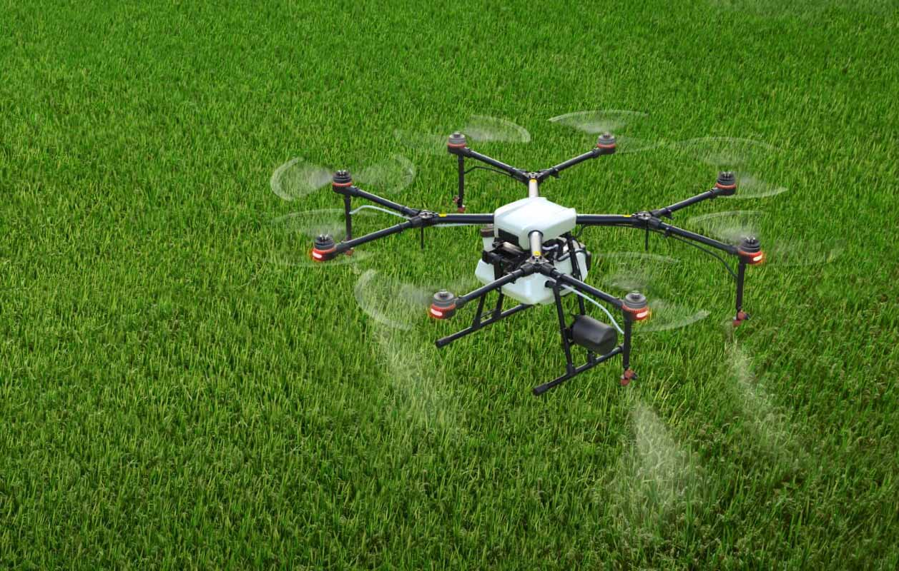
INTRODUCTION
An agricultural drone is an unmanned aerial vehicle used to help optimize agriculture operations, increase crop production, and monitor crop growth.
Sensors and digital imaging capabilities can give farmers a richer picture of their fields.
Using an agriculture drone and gathering information from it may prove useful in improving crop yields and farm efficiency.

Slide 5
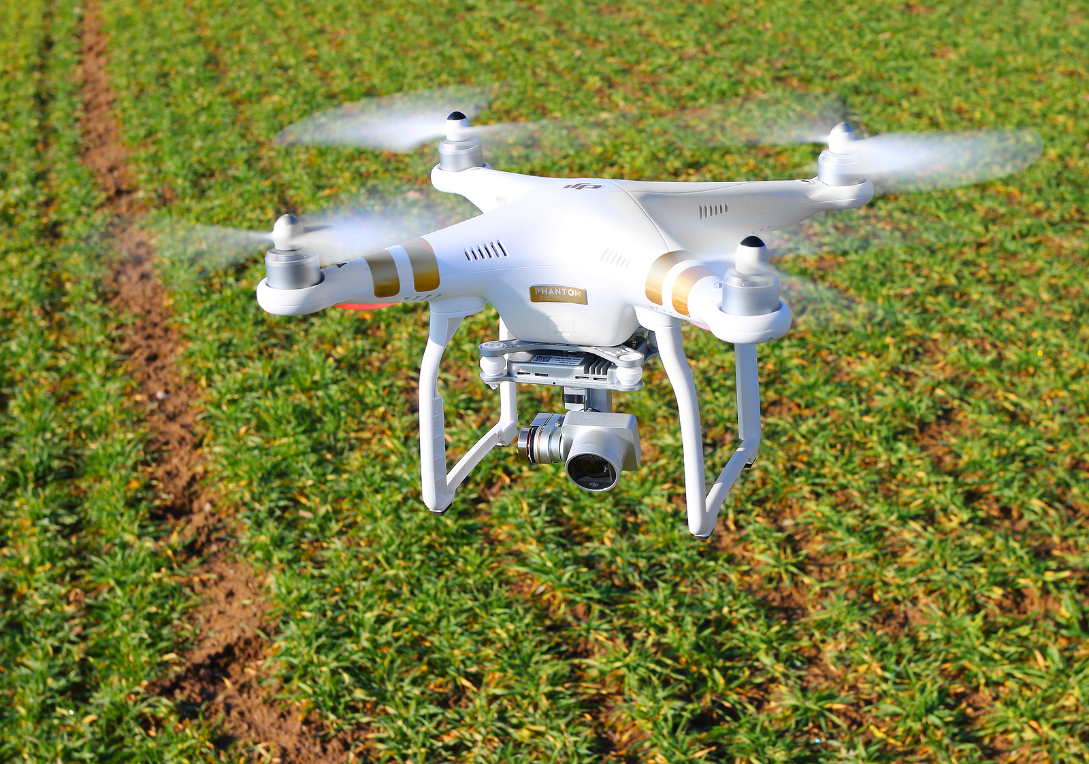
ABSTRACT
Agriculture is oldest profession of mankind. Very specifically, 80 percent of Indian population is engaged in agriculture related activities.
No one can deny that farmers are losing their lives due to unmanageable debts increase due to failure of crops. Crop failures are due to various reasons.
One of the main reason in crop failures is due to manual based, very traditional and un-scientific agriculture practices. In this work, an intelligent system is developed to watch the development of crops and various other very timely parameters of crops development.
The new system proposed here consists of a flying drone fitted with a camera eye to record images of crops in a scheduled time. The work involves developing an intelligent system by building a knowledge-base to guide agriculturists. The knowledge-base includes various cases of various crops and decisions based on crop image analysis. From captured images, the parameters that are planned for analysis by image processing are, the amount of green in leaf detection, moisture content in soil with supporting IoTs etc. The image of the plant will be acquired using the external camera eye fitted on drone which is interfaced with Raspberry Pi along with other different sensors modules through IOT. To detect green leaf we have to install Android studio in which PlantDoctorMaster-debug.apk file is created. Now we have to copy this apk file in the handset where TH classify application is installed.

Slide 6
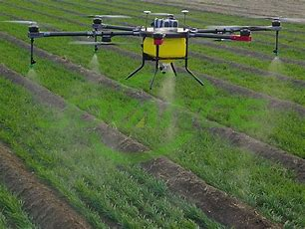
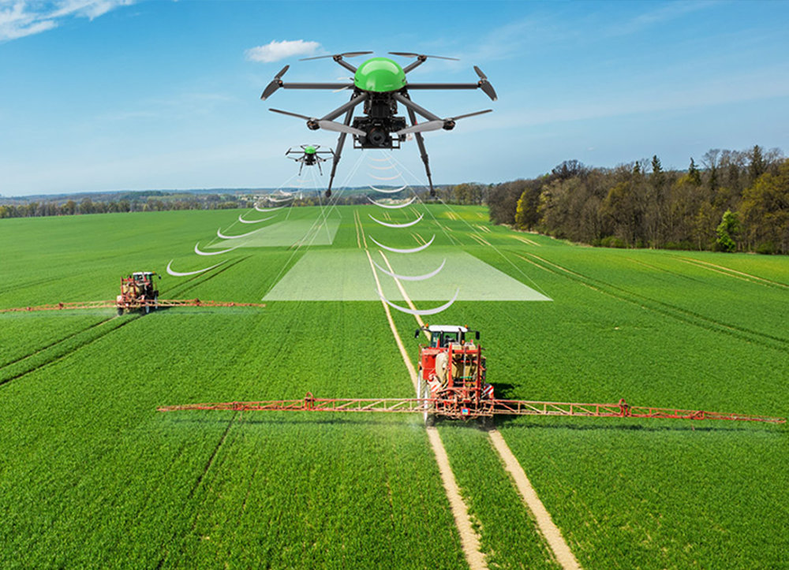
WHAT IS AGRIDRONE….?
The drone flies itself according to a mission that is pre-planned. Unmanned Aerial Vehicles (UAV) has been in use since 1980 and their applications are expanding rapidly.
There are various applications of drones right from simple photography to military spy. As IoT (Internet of Things) becomes more commercialized, various IoT concepts can be integrated into agriculture drones to help improve agriculture.
India’s main source to increase the economy of nation is agriculture. Majority of industries depends on products of agriculture. The improvement in technology is essential to yield high crop rate.
Drones are high and reliable instruments flying in the sky and can be used by farmers to inspect the farms conditions at the beginning of any crop year.aising the throttle till the drone has lifted off.

Slide 7
LITERATURE SURVEY
Deepak Murugan - “Development of an Adaptive Approach for Precision Agriculture Monitoring with Drone and Satellite Data”[2017] . Have proposed an approach for precision agriculture monitoring. It helps to distinguish between a sparse and a dense field using available data from the satellite and the drone. This approach works with image statistics of a region and helps to minimize drone activity.
Paolo Tripicchio - “Towards Smart Farming and Sustainable Agriculture with Drones.”, International Conference onIntelligent Environments (IE), [2015]. Have stressed on the popularity of drones used in agriculture. With the help of an RGB-D sensor connected to the drone, various ploughing techniques can be distinguished. Two different algorithms are used to differentiate between the ploughing fields.
Marthinus Reinecke - , “The influence of dronemonitoring on crop health and harvest size.”, 1st International Conference on Next Generation Computing Applications (NextComp), [2017]. Have proposed the usage of drones for the betterment of crop quality. This could help the farmers increase their production by detecting the loopholes beforehand. The crops could be managed by using specific cameras connected to the drones to detect water shortages and harmful pests.
Floriano De Rango - “A simulator for UAVs management in agriculture domain.”, International Symposium on Performance Evaluation of Computer and Telecommunication Systems (SPECTS), [2017]. Have proposed the usage of a simulator that is suited to the agricultural fields. This simulator would coordinate with the UAV and control the activity of the UAV in the presence of harmful insects in the crops. It would also consider various other parameters like energy and the communication range of the drones.
Rodrigo Filev Maia - “Precision agriculture using remote monitoring systems in Brazil.”, IEEE Global Humanitarian Technology Conference (GHTC), [2017]. Have discussed about an IoT device which is used to monitor various agricultural parameters. The device uses a network of sensors for measuring the soil temperature, humidity, moisture etc. The test was carried out in Sao Paulo, Brazil. Reference climate data was taken to support various decisions on crop life and its sustainability.

Slide 8
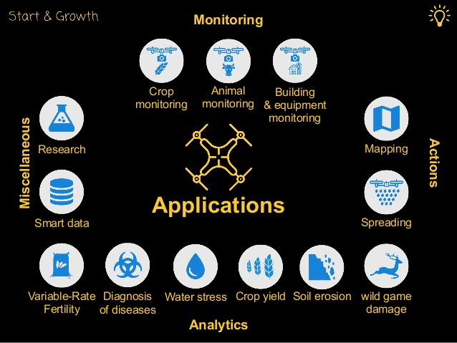
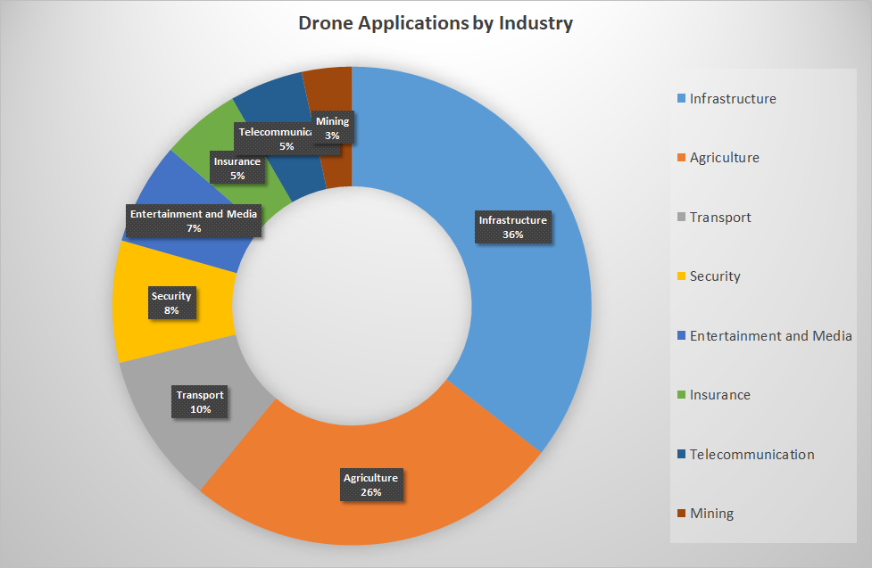
APPLICATIONS

Slide 9
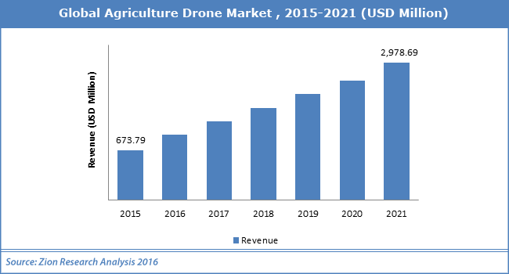
AGRIDRONE MARKET

Slide 10
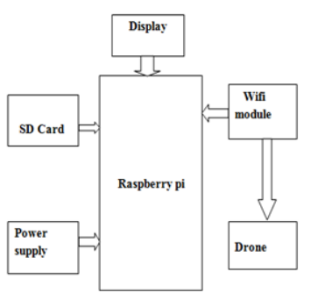
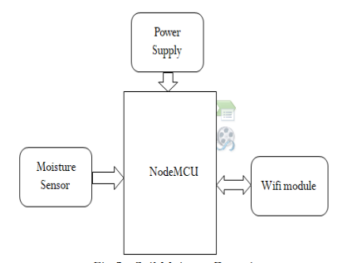
PROPOSED SYSTEM ARCHITECTURE
The Drone is connected through wifi module to capture the images. Through raspberry pi we can able to send the obtained converted digital equivalent of the parameters over the internet and opencv allows this to process the drone. The Raspberry pi is connected to the Display through HDMI cable and the power supply is given to it. We use hard disk (SD card) for the storage.
To detect the moisture in the soil we use NodeMCU which is connected to the power supply through Wifi module and moisture sensor is connected to the breadbroad which is used to check the moisture content in the soil and to check the dry land.
Green Leaf Detection
Soil Moisture Detection

Slide 11
Raspberry pi The Raspberry Pi is a series of small single-board computers developed in the United Kingdom by the Raspberry Pi Foundation. Raspberry pi consists of 40 pins in which 8 pins are Ground pins and 4 pins are Power pins i.e power pins are 1,2,4,17 and ground pins are 6,9,14,20,25,30,34,39. Processor speed ranges from 700 MHz to 1.4 GHz,memory ranges from 256 MB to 1 GB RAM SD cards are used to store the operating system.The board have 4USB ports. For video output,HDM1 port is supported. .It is an ARM-based low cost and tiny SBC (Single Board Computer).
Drone Unmanned aerial vehicle technology covers everything from the aerodynamics of the drone, materials in the manufacture of the physical UAV, to the circuit boards, chipset and software which are the brains of the drone. This UAV is ideal to explain drone technology because it has everything in one package. It includes the UAV, gimbal and camera and uses some of the top drone technology on the market today.
Node MCU NodeMCU is an open source IoT platform. It includes firmware which runs on the ESP8266 Wi-Fi SoC from Espress if Systems, and hardware which is based on the ESP-12 module. The term "NodeMCU" by default refers to the firmware rather than the development kits. The firmware uses the Lua scripting language. It is based on the eLua project, and built on the Espress if Non-OS SDK for ESP8266. It uses many open source projects.
Soil Moisture Sensor Soil moisture sensors measure the volumetric water content in soil. Since the direct gravimetric measurement of free soil moisture requires removing, drying, and weighting of a sample, soil moisture . sensors measure the volumetric water content indirectly by using some other property of the soil, such as electrical resistance, dielectric constant, or interaction with neutrons, as a proxy for the moisture content.

Slide 12
EXISTING WORK DESCRIPTION
Considering connections, In this work, Drone is fitted with camera eye via Wi-Fi module which is used to capture live images and Videos.
To capture live images and videos we have to install THWiFi FPV application in the mobile phone and they are stored in the same application.
To detect Moisture content in the soil, the following connections are to be followed. Connect the two pins of the moisture sensor to the two pins on the Amplifier circuit using jumper wires.
Connect the Vcc from the Amplifier to the 3.3V pin on the NodeMCU. Connect the GND pin to the ground (GND) pin on the NodeMCU. Connect the Analog pin to the A0 pin on the NodeMCU. Connect NodeMCU to PC via a USB cable.
Now sign in to the “Thingspeak” now go to tools click board > NodeMCU1.0>Port and choose the right port and now upload the code. Now click on private view where the graph is displayed with time and date. If there is no moisture content in soil then it is considered as Dry land and fixed value of Dry land is 1024. To detect green leaf we have to install Android studio in which PlantDoctorMaster-debug.apk file is created. Now we have to copy this apk file in the handset where TH classify application is installed. In this application select the photo captured by the Drone and the image is stored in the Raspberry pi and now diagnose the result of the selected image and we will get the confidence value.

Slide 13
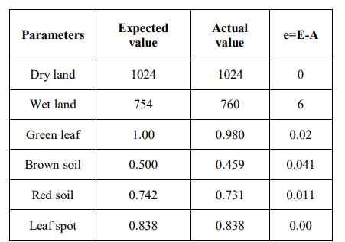
TEST CASES

Slide 14
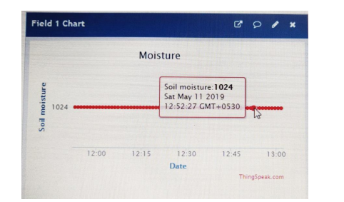
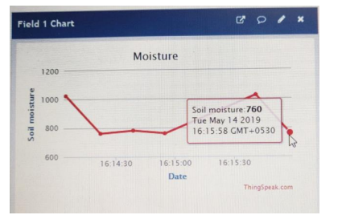
TEST RESULTS
Dry Land Detection
Wet Land Detection

Slide 15
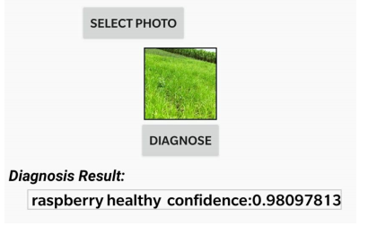
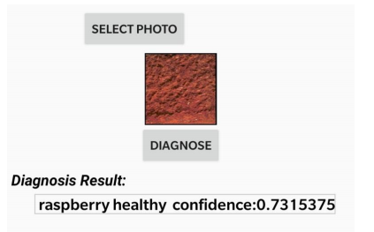
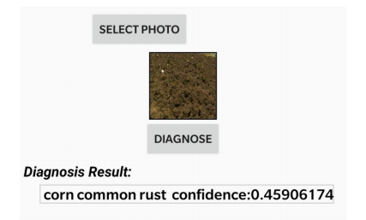
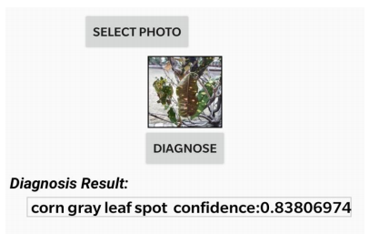
Green Leaf Detection
Red Soil Detection
Brown Soil Detection
Leaf Spot Detection

Slide 16
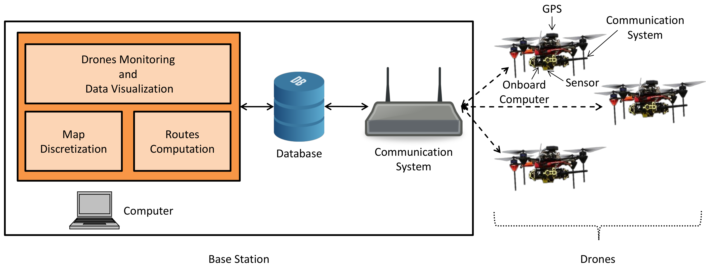
AGRIDRONE BLOCK DIAGRAM

Slide 17
CONCLUSION
Drones or UAVs will be of immense help in the field of agriculture with the increase in population as they are essential at the very beginning of a crop cycle. It will not only reduce time but also yield better cultivation based on analyzed data.
Crop management will be more efficient due to systematic monitoring. With the upcoming technologies, the production rate will increase rapidly with lesser consumption of energy. The major advantage of Drone is the auto landing capability which reduces the risk factors designed in a simple and cost effective manner.
The study investigated the importance of drones in agriculture and is regarded as an eye-opener in industry and agriculture for development and integration of more drones for making agriculture tasks better in near future.

Slide 18
REFERENCES
J. Primicerio et al -, A flexible unmanned aerial vehicle for precision agriculture. Precision Agriculture 13(4), 517-523, 2012(Volume:115, Issue:7)
Lei Shi, Qiguo Duan, Xinming Ma, Mei Weng,”The Research of Support Vector Machine in Agricultural Data Classification”,International Conference on Computer and Computing Technologies in Agriculture, CCTA 2011: Computer and Computing Technologies in Agriculture V pp 265- 269.(Volume:76,Issue:43)
Marthinus Reinecke, “The influence of drone monitoring on crop health and harvest size.” 1st International Conference on Next Generation Computing Applications (Next Comp), 2017. (Volume: 75, Issue:6)
Paolo Tripicchio, “Towards Smart Farming and Sustainable Agriculture with Drones.”, International Conference on Intelligent Environments (IE), 2015.(Volume:44, Issue:81)
Petterson,“Recent trends in the Internet of Things”, IEEE 7th Annual Computing and Communication Workshop and Conference (CCWC), 2017(Volume:412, Issue:77)
Rodrigo Filev Maia,“Precision agriculture using remote monitoring systems in Brazil.”, IEEE Global Humanitarian Technology Conference (GHTC), 2017. (Volume:36, Issue:79)
Theerapat Pobkrut, Tanthip Eamsa-ard, eerakiat Kerdcharoen, “Sensor Drone for Aerial Odor Mapping for Agriculture and Security Services”.(Volume:87, Issue:16)
Xie,”The Research of Support Vector Machine in Agricultural Data Classification”, International Conference on Computer and Computing Technologies in Agriculture, Computer and Computing Technologies in Agriculture.(Volume:24, Issue:41).

Slide 19
THANK YOU…..!

Slide 20
ANY QUERIES…?

